Slide 3

Oracle Mobile Strategy Overview
Anirban Bagchi
Principal Mobility Consultant
North America Mobile Specialist Team

Slide 4

Agenda
1
Why do anything?
Re-Think Mobile
Simplify Enterprise Mobility
Oracle Mobility Strategy
2
3
4
Notes:
Main Points: Mobile and specifically enterprise mobility topic continues to be the topic on everyone’s mind. In today’s session and Mobile track we will go through the following agenda sections:
Transform The Enterprise – discuss how mobile is playing a key role in the digital and or mobile transformations across industries, with organizations large and small around the world
Rethink Mobile – discuss what we have learned especially in the past decade and discuss why it is time to Rethink Mobile … and look to thinking beyond having a Mobile-first strategy,
Simplify Enterprise Mobility – discuss Oracle Mobile’s core value proposition and strategy to simplify enterprise mobility.
In the Future… What next? – discuss where we are going … how Oracle is continuing to invest in mobile platform to simplify enterprise mobility
Let’s get started.

Slide 5

Re-Think Enterprise Mobility
Mobile App(s)
“Old Things, New Ways”
Transformation ?!?!
Requires Enterprise Mobile Strategies
“New Things, New Ways”
Enterprise Mobility
Notes:
What I plan to cover this morning is share with you how mobile is playing a key role in the digital transformation, lessons we have learnt, our strategy at Oracle to simplify enterprise mobility and our investment in product and technology that is going to help you invent the future.
Rapid proliferation of mobile devices
Mobile everywhere (tablets, phones, wearables, appliances)
Bring Your Own Device (BYOD )
Customer experience and loyalty
New revenue streams
New business processes
Competitive Differentiation
Productivity & Efficiency
Agility

Slide 6




The New Frontier . . .
The Connected Consumer
The Connected World …
The Connected Enterprise
Notes:
Main Point: The next frontier for mobile is about much more it is about the internet of things and mobile coming together and creating the Connect Enterprise .. In fact one of say that as our worlds more connected, the consumers demand to be more connected, the enterprise has room to catch up to consumers and the world in how quickly the enterprise gets connected with its employees, customers, partners, etc.
The ability to leverage mobile technology and make it meaningful by finding significant links to multiple, varied sources of data (for example linking biometric values with environmental factors, or calendar data with home control and monitoring) is what will lead to promising developments across industry segments. Oracle understands this and recognizes that the same mobile apps that are developed with Java based tools are now integrated across devices as watches, etc.
I think it’s even bigger than that phrase implies: I believe we’re seeing the beginning of a total connected world, where everyone is connected to everything.

Slide 7
Rethink Mobile

Slide 8
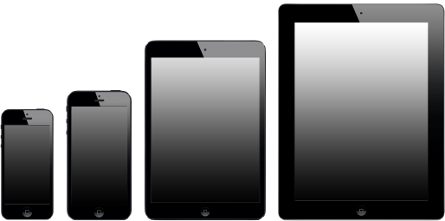
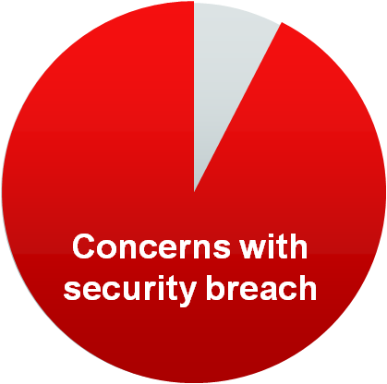
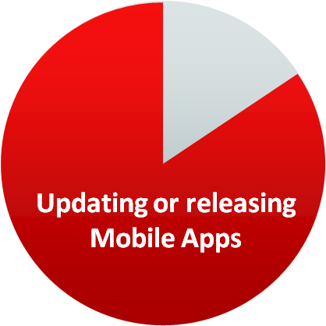





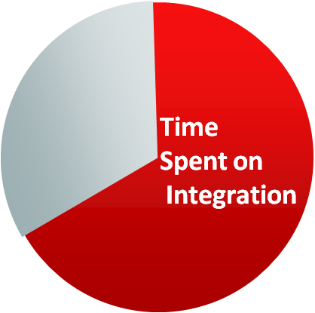

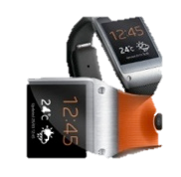
Enterprise Mobility Challenges
Bring Your Own Device
(BYOD)
Multiple Form Factors
Multiple Mobile OS
Enterprise Integration & Security
93% of enterprises are concerned with data loss and security breaches
74% Allow some sort of BYOD usage.
74%
Form
Factors
87% of enterprises are updating or releasing mobile apps every 6 months or less
Less than 10% “FULLY AWARE” of the devices accessing their network
Mobile
OS
10%
2/3 of the time spent on mobility projects is securely integrating to back-end systems
IoT
Forbes: Mobile Business Statistics For 2012
Source: 2014 Triangle Research Survey
Notes:
Main Point: Clearly offers a great deal of opportunities for everyone including the enterprise however there are challenges. In a recent research report Oracle conducted with CIO Strategic Insights and Triangle Research here are some key findings:
93% of enterprises are concerned with data loss and other security breaches related to mobile devices
2/3 of the time spent on mobility projects is connecting to, and securing back-end systems
87% of enterprises are updating or releasing mobile apps every 6 months or less
For more information on the survey you can view the webcast and download the survey paper at www.oracle.com/mobile

Slide 9
Re-Think Enterprise Mobility
Think Mobile interaction everywhere: voice, touch, messaging
Think access to relevant and related information anywhere, anytime
Think securing the data instead of device
Think analysis anytime, enable action in real time
Think accelerated agility, not perfection
CLOUD
cLIENT
context
CONTENT
Notes:
Main Point: It is time to Rethink, it is not just about having a that great looking mobile app and a framework that enables you to develop something quickly --- it is also about the content, context and leveraging the Cloud to deliver, integrate, secure, deploy and analyze the performance of these mobile apps quickly and efficiently. It is time to:
Think Mobile interaction everywhere: voice, touch, messaging
Think access to relevant and related information anywhere, anytime
Think securing the data instead of device
Think analysis anytime, enable action in real time
Think accelerated agility, not perfection
Beyond Mobile First
Talking enterprise mobile.. You need to address the front end mobile, back-end mobile infrastructure, and data strategy
Front end – who are you users, mobile app architecture (native, web, hybrid) and the skills needed to build these apps, security on the device (SSO, data security), managing the device (or really the applications on the device) depending on your device policies (BYOD, COPE), capabilities leverage on the device (often impacts the client architecture.. Not just the device capabilities like location services, scanning, pics, audio, etc.. But data synchronization for off line usage), App portfolio (how many apps, users), etc.
Backend Mobile - what are you integration policies, types of data your accessing, API’s and who is building & managing those API’s (re-usability, security, skills, etc), security (data security, role based security and how it integrates with the app, security on data in transit, deploy the apps (public app store enterprise app store), governance around all this,
Data strategies – and what you do with the data. Integrating into your OLTP systems, tied in with your big data strategy (lots of data), analytics.. Customer loyalty.. How do you drive personalization based on the data, IoT… how does it tie into your product strategies or hw does the data impact your business processes? What content are you exposing ?
Gartner – 25-30% of your effort on front end…. 70-75% effort on the backend

Slide 10

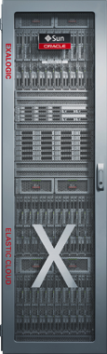
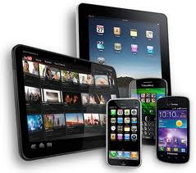

Enterprise Mobility begins with a “Mobile Plus” Architecture
“Device 2 Data Center”
OLTP
Mobile Capabilities
Big Data
Develop
DEPLOY
Integrate
MANAGE
DW / Analytics
Secure
IoT
General Content
Notes:
Beyond Mobile First
Talking enterprise mobile.. You need to address the front end mobile, back-end mobile infrastructure, and data strategy
Front end – who are you users, mobile app architecture (native, web, hybrid) and the skills needed to build these apps, security on the device (SSO, data security), managing the device (or really the applications on the device) depending on your device policies (BYOD, COPE), capabilities leverage on the device (often impacts the client architecture.. Not just the device capabilities like location services, scanning, pics, audio, etc.. But data synchronization for off line usage), App portfolio (how many apps, users), etc.
Backend Mobile - what are you integration policies, types of data your accessing, API’s and who is building & managing those API’s (re-usability, security, skills, etc), security (data security, role based security and how it integrates with the app, security on data in transit, deploy the apps (public app store enterprise app store), governance around all this,
Data strategies – and what you do with the data. Integrating into your OLTP systems, tied in with your big data strategy (lots of data), analytics.. Customer loyalty.. How do you drive personalization based on the data, IoT… how does it tie into your product strategies or hw does the data impact your business processes? What content are you exposing ?
Gartner – 25-30% of your effort on front end…. 70-75% effort on the backend

Slide 11
Oracle Mobile Strategy

Slide 12
Oracle Mobile Platform Strategy
Build Your Own Apps
Oracle’s Mobile Apps
APP
Mobile Security
ORACLE MOBILE Platform
Notes:
ORACLE’S MOBILE STRATEGY is to simplify enterprise mobility. Our complete offering includes a mobile platform that can be used to develop, connect and secure your own mobile apps. In addition, mobile security is integrated with the Oracle Mobile Platform and can be leveraged separately as part of your overall enterprise security architecture. Finally, Oracle and partners continue to deliver new, custom and or out-of-the-box mobile apps every day.

Slide 13
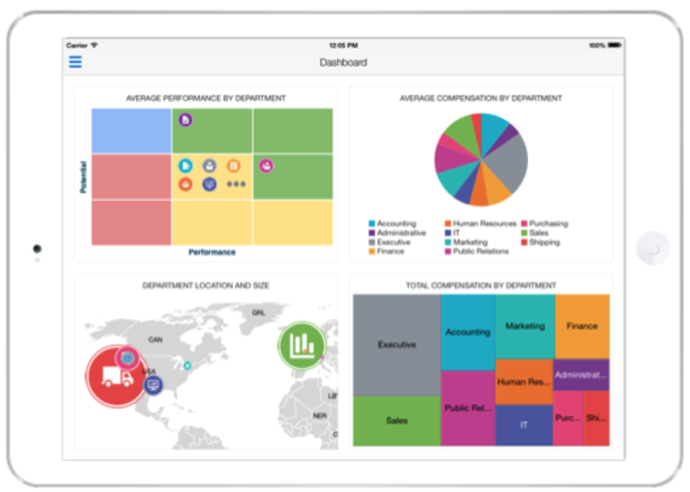
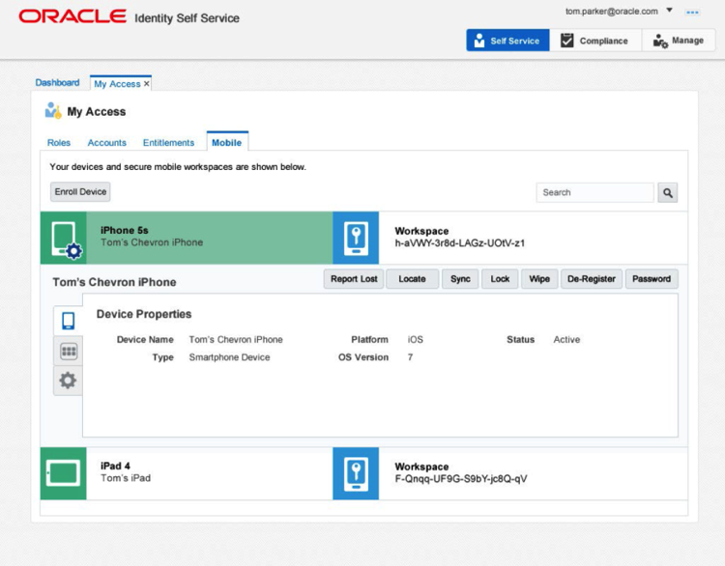
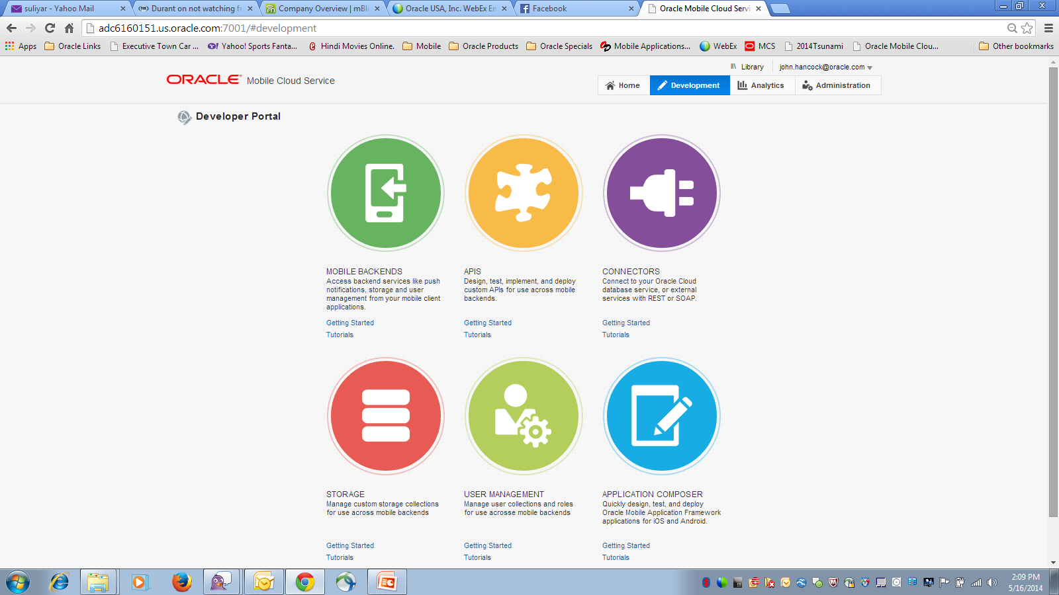
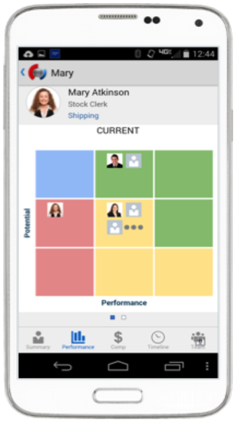
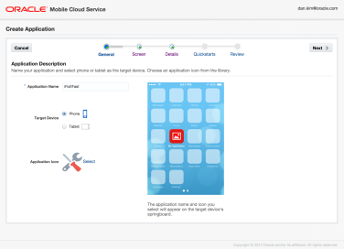
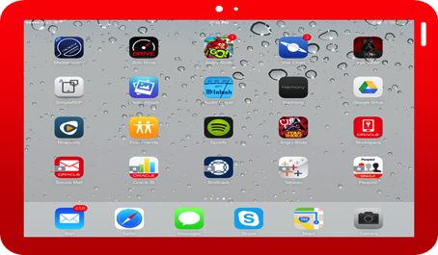
Oracle Mobile Platform Strategy
Develop, Integrate, Secure, Deploy & Manage
Develop
Integrate, Monitor & Analyze
Secure, Deploy & Manage
Mobile Application Framework
Mobile Cloud Service
Mobile Security
Notes:
Oracle’s platform strategy has 3 main components. All of these components are integrated but de-coupled. You can mix and match any of these components. Mobile Cloud Service is our key offering for providing all the enterprise backend services that mobile client developers will need to deliver mobile applications.
MAF provides all the tools for mobile client tool developers to build cross platform mobile applications
Oracle Mobile Security provides the complete enterprise mobile management components including MDM, MAM, MIM, MCM

Slide 14
Oracle Mobile Platform

Slide 15

Oracle Mobile Cloud Service
@OracleMobile
Oracle Confidential – Highly Restricted
15

Slide 16
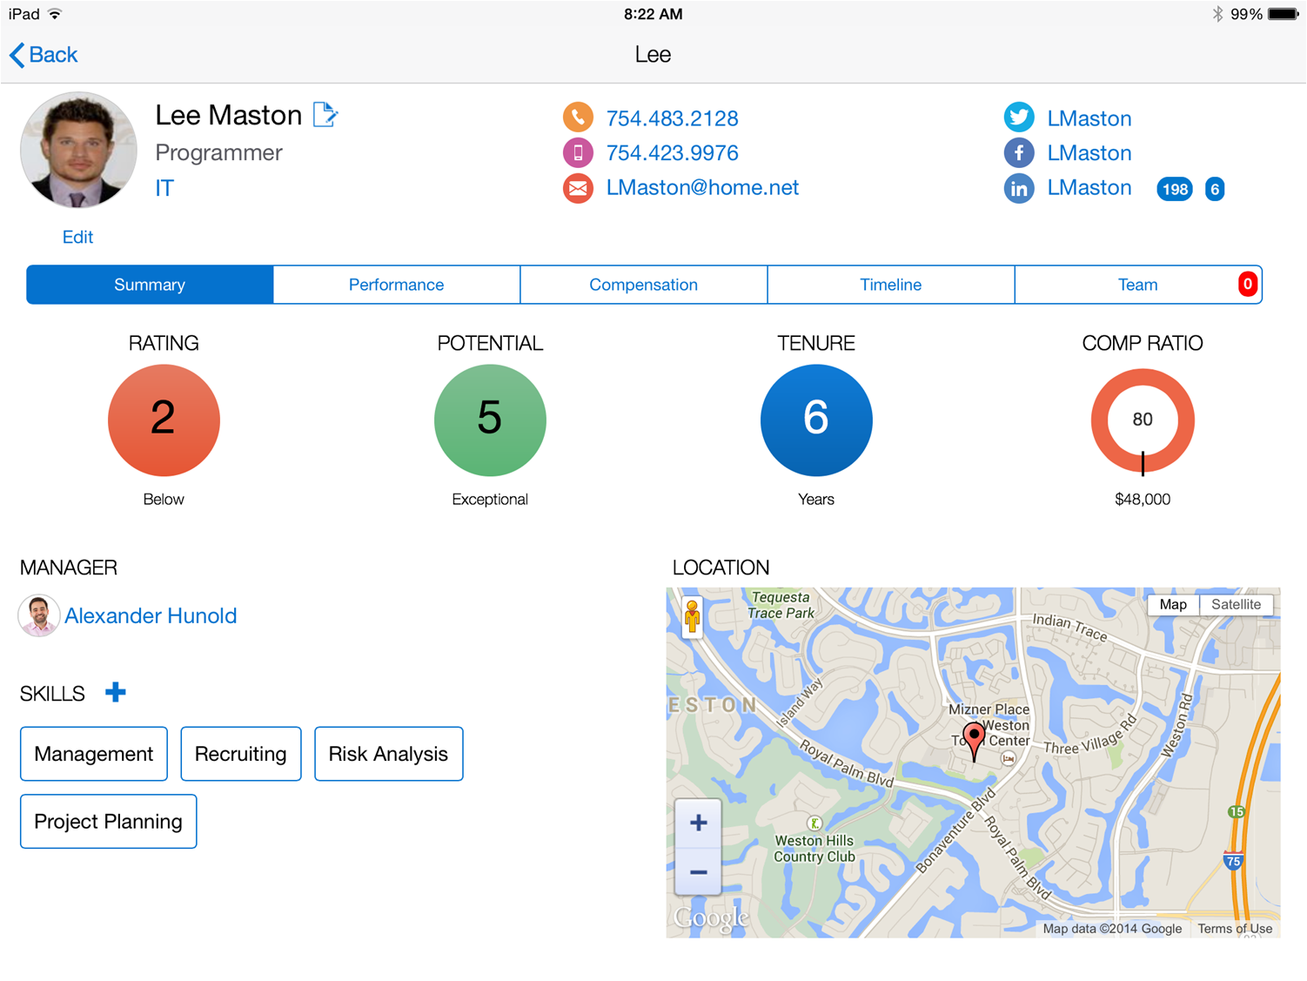
Lets start with a Mobile App. A simple HR Mobile App
Notes:
In order to explain what MCS is, let us first take a look at why we wanted to build MCS from the outside – in.
Imagine that as a mobile developer you were asked to build a mobile app that looked like this – a very simple, elegant HR mobile designed for the HR rep or a manger to use. This screen in this looks relatively simple and has all the data the user needs about their employee.
It has information about the employee, their contact details, their social networking information, their performance information, talent management information, their location etc.
Overall a simple app to build.

Slide 17
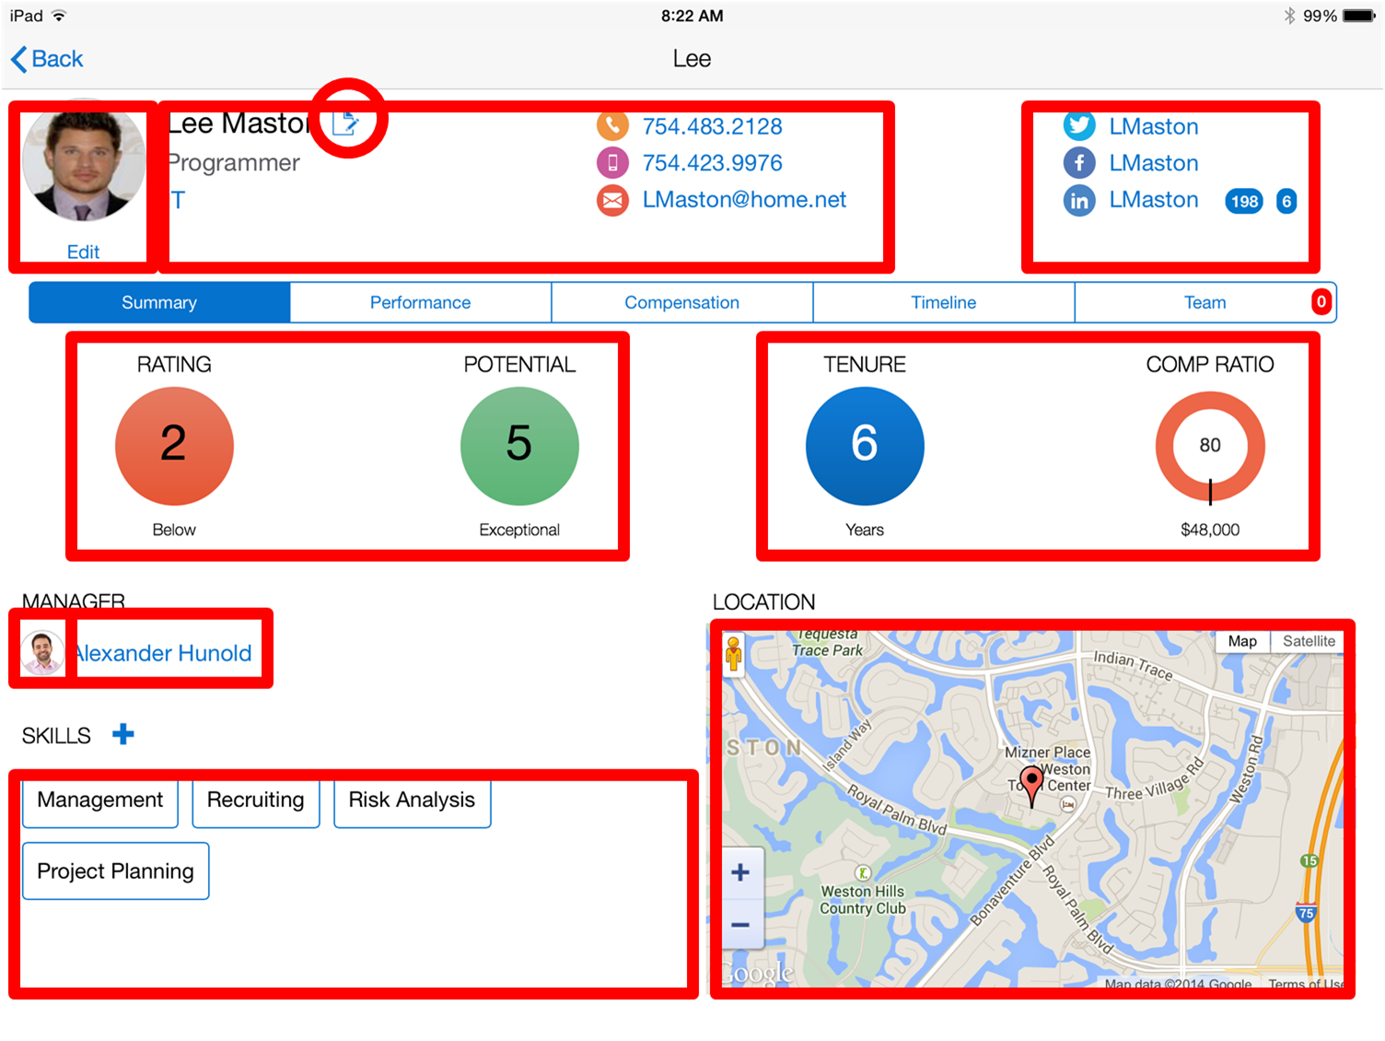
Let’s decompose this app
Notes:
However, when you now start to decompose the app and start highlight the different areas you are mashing up the data for this app, you will realize that (go to the next slide)

Slide 18
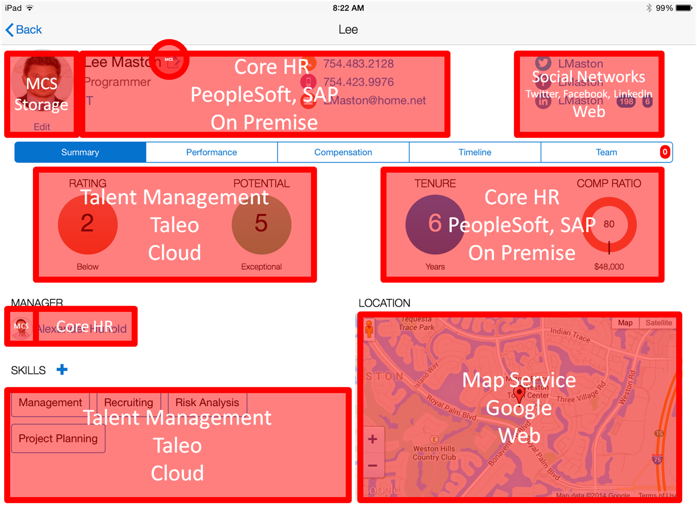
And map it to the systems of record
Notes:
That in fact this simple app is quite complex in that you need to integrate data from multiple systems of record. For e.g. let’s say the HR systems were different based by geo – on premise (SAP in Europe and Oracle PeopleSoft in US), the talent information came from Taelo – a SaaS app Social networking came from LinkedIn, FB and Twitter. Mapping service from Google. This enterprise wants to store employee photo but the backends may not be set up for storing images.
While creating the front end is a relative easy task trying to integrate this data, map user identity and security policies and getting different APIs together is what takes the longest time

Slide 19

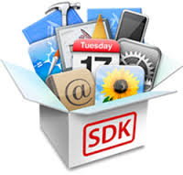




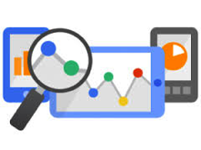


















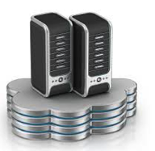
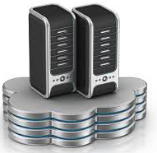

This simple app soon became complicated to develop…
Client Dev Tools
Monitor & Analyze
Mobile Services
Integration
Security
Multiple Environments
Notes:
So now the mobile developer has to figure out
What tool will they use to build the mobile, native or cross platform ?
How do they integrate to these multiple systems of record – 7 in this case
What are the user identity policies for these backend systems. They may be different based on the authentication policy of the backend
IT would need to provide environments for dev, test and prod – multiple environments since the app is not static and will have continuous development
What about adding mobile services like the ability to work in an offline mode, to get push notifications, add geo coding to the employee record
What about diagnostics, analytics to determine how the app is performing, who is using the app etc
In summary, there is a lot that goes on in building a mobile app. Building the UI becomes the easy part. The hard part is managing all these other areas.

Slide 20


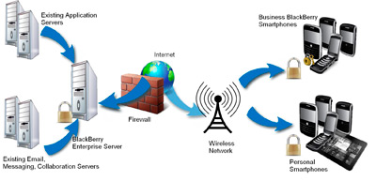

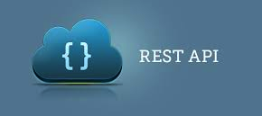


Why Mobile Integration is Different to Traditional Integration?
Connection Availability
Lighter Protocols
Smaller Payloads
Real time higher transaction volumes
Backend APIs not Mobile ready
Wireless Data Plan Cost
Power Savings
End to End Security
Multi Form Factors
Notes:
Why is mobile integration different and hard than traditional enterprise integration. Traditional enterprise integration usually has been about app to app integration or creating a common service bus for web based applications. Mobile applications are different.
They need to deal with poor or no connection. So apps needs to operate in a disconnected mode
Even 4G networks cannot handle all the load. So you need optimized packets in lighter protocols like REST
Mobile apps are purpose built. Backend interfaces may have additional fields that are not required.
Mobile users are unpredictable in their use – you have to architect for an always on, real time flow with high transaction volumes
Legacy backend (on premise) and even the new SaaS application interfaces were not designed for mobile. One issue with the sheer volume of traffic generated with fields that are not needed. The other is with orchestrating 2 or more APIs in one payload to get maximum user experience. Imagine a UI that has data coming from multiple APIs that were dependent on the results of one API e.g. based on “my customers” to get my opportunities, their status and be able to change it. This could result in multiple API calls in the background instead of one
The back and forth of this data impacts wireless data plan cost and device power.
Mobile integration needs to understand complete end to end secuity. There is device security, mobile app credentials, mapping to multiple backend credentials.
And of course the need to build apps to multiple device sizes and in some case headless IoT devices.

Slide 21
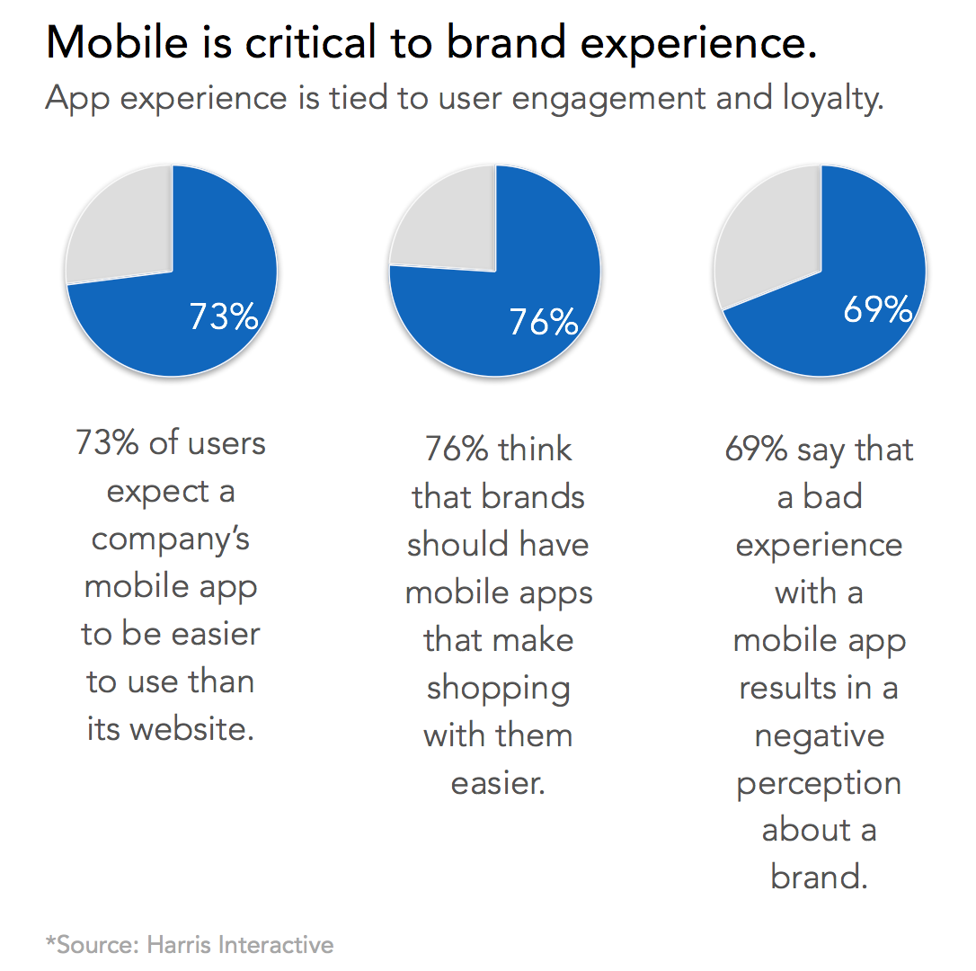
Why Mobile Analytics ?
Mobile Analytics Challenges
CIO: No ROI dashboard with insights into mobile strategy execution
LOB: No insights into application adoption and usage for personalized engagement
Developers: Very complex to measure and derive insights on application crashes and performance
Business Value
Retail Co.: Personalized engagement with users lead to over 20MM downloads = $13B in gross sales via mobile devices
Media Co: Grew digital subscription 50% in 12 months. Segmentation helped with creating profiles to increase reach to 1.3 million people per month
Company with $1B in annual mobile revenue e.g. Starbucks, Domino’s Pizza
97% uptime = $2.5M loss / month
99% uptime = $0.8M loss / month
99.9% uptime = $82K loss / month
Notes:
Many enterprises feel that they have not getting the intended ROI from mobile applications. Many enterprises have jumped into mobile apps with a ready fire and aim strategy without thinking through the business case and ways to drive user adoption. This is true for both B2C apps and B2E apps. B2C apps for most part have app store metrics that provide download numbers or ratings but that is not enough to drive user engagement.
Mobile analytics is a very important area to consider during the mobile development process. This is not quite the same as web analytics where instrumentation is done at the web server end and can be done retroactively. Mobile apps needs to be instrumented during development time to really understand the real extent of application performance and usage. Use one of the stats from the Harris poll to highlight the challenges of not having mobile analytics – you cannot analyze what you cannot measure.
For the CIO :
- The CIO is under pressure to deliver a portfolio of mobile apps by the LOB. However with limited resources, the CIO needs a dashboard on adoption of the apps and the ROI associated with their investment. They have no dashboards that helps them determine which apps should continue to get investment, which apps needs higher user adoption and which apps perhaps do not need any additional investment.
For the LOB:
Very limited insights into usage, retention, identifying who to engage to drive either higher adoption or higher revenue. Ensure for B2C the right campaigns or ads sent at the right time and location.
For the developer / architect
No visibility into app performance, app crashes, what was the overall environment when the app crashed (device, network, other aps etc)
Highlight the impact that Mobile Analytics can bring to the business with the examples on the slide

Slide 22
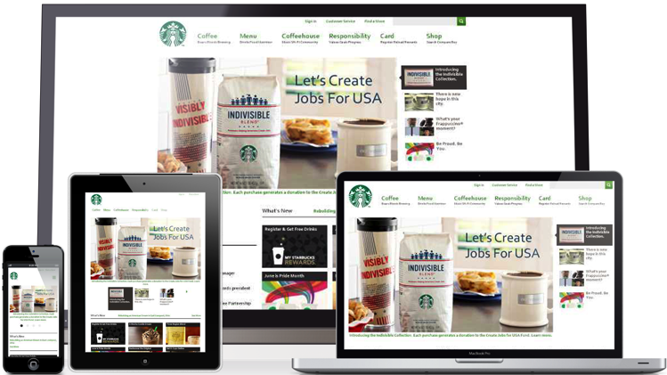





The Answer – Mobile Cloud Service
Making Mobile Simple
Mobile
Cloud Service
Consumer style
front-end experience
Enterprise grade
backend
Systems of Record
&
Services
Notes:
So what is the answer to solving these problems – Mobile Cloud Service
Whether it is consumers or employees, they expect superior front end experience, tying to a secure enterprise grade backend service that connects and integrates to multiple systems of record and services.

Slide 23
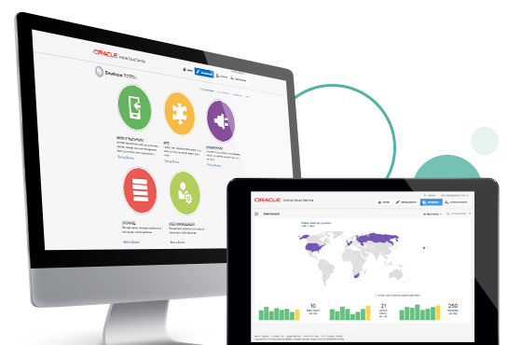
Oracle Mobile Cloud Service
Simplifying Enterprise Mobility: Easily connect mobile app to enterprise backend services & security
Speed Innovation & Agility: Keep pace with business needs, create personalized engagement
Reduce Cost: Reduce cost & risk of mobile connectivity to enterprise data centers
Personalize Engagements: Measure, analyze, engage and increase mobile ROI
Oracle Confidential – Highly Restricted
Notes:
MC benefits:
Speed innovation and agility –
keep pace with business needs and mobile app client development,
Add mobile centric features – push, sync, storage, diagnostics, analytics,
Get insights into Mobile Portfolio ROI
Reduce cost –
Reduce risk of mobile connectivity into enterprise data centers
Get insights into Mobile Portfolio ROI
Simplify Enterprise Mobility:
easily connect mobile app to enterprise backend services & security
Hire less experienced mobile developers and enable them with enterprise grade services
Increase mobile adoption and personalize engagement

Slide 24






Geared for all involved Personas
Line of Business Stakeholders
“I am responsible for the success of our mobilization strategy”
Enterprise Architect
“I make sure we have a secure, scalable solution”
Amanda – MCS Administrator
Mobile App Developer
“I create the mobile applications that call backend services”
Service Developers
MCS Admin
MCS Admin
“I administer MCS for our company”
.
Service Developers
“I create the backend services that mobile applications call”
LOB Stakeholder
Enterprise Architect
Mobile Developer
Notes:
Any successful mobile application is a collaboration among multiple groups within the enterprise. Gartner recommends a bimodal approach to unite IT teams and combine agility with stability to address digital opportunities. MCS was designed with a persona based approach with a deep understanding on the roles and needs of these personas and the tools required to make it easy for these personas to deliver on their roles and functions and to collaborate with the other personas. A quick look at the personas, focal with Mobile Cloud Service.
All starts with the LOB Stake holder that has the business requirement – they are responsible for the overall success of the mobile app.
Mobile client developer – responsible for building the client side engaging experiences and consuming services provided from the mobile backend
Service developers – developing or shaping services for mobile client developers to consume
IT Architect – ensuring IT security and architecture compliance
MCS admin – managing the operational maintenance of MCS

Slide 25



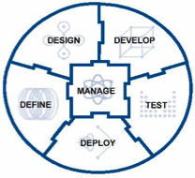



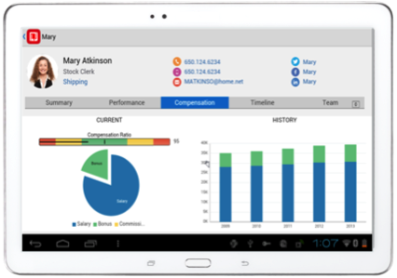




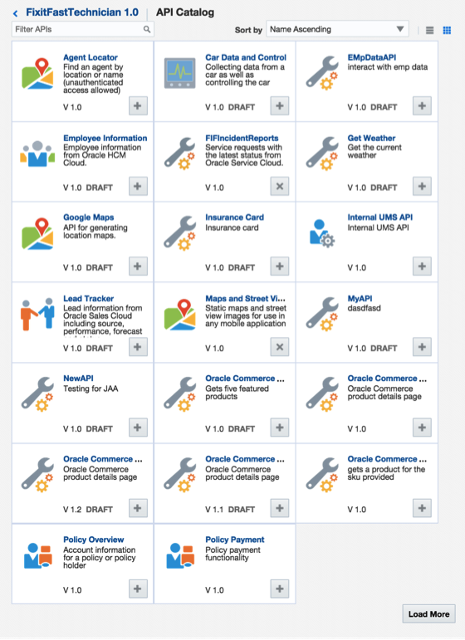








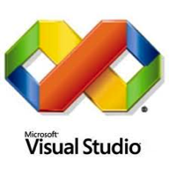



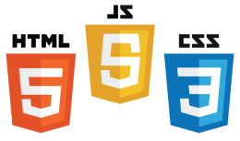





Oracle Mobile Cloud Service
Outside-in, Mobile First
Analytics
Continuous Development
MOBILE APPLICATION FRAMEWORK
Diagnostics
Usage
Engagement
Monitoring
Inside-out, Service first
SDLC
Built-in APIs
Offline Sync
User Mgmt
Native
Mobile
Cloud Service
ICS
OSB / SOA
Cloud
Notifications
Storage
Connectors
Mobile APIs / SDKs
SECURE
Public Cloud
Oracle Cloud
Enterprise SaaS
On-premise
On-Premise Packaged Applications
3rd Party API
Others
Custom API
Users
Data Shaping
Objs
Custom
Logic
Orchestrate
CUSTOM Applications
Notes:
The Oracle Mobile Service goal is to easily enable mobile application developers that are continually looking for new ways to accelerate development of apps to meet their consumers’ needs. MCS is a set of cloud-based, server-side mobile services to make app development quicker and easier to deploy. MCS reduces the complexities of the application development by dealing with the complex server side programming, reducing the redundancy in creating backend code blocks, providing ready to integrate features and template backend.
Developers can focus more on the front end of the applications and can have their choice of mobile client development tools including ADF-Mobile for cross platform hybrid apps, native development or other Javascript tools – creating a new meaning for BYOD – Bring your own development
MCS provides a set of rich RESTFul interfaces for all the operations required by the mobile app that abstracts the backend from the mobile developer. In addition it also provides mobile specific interfaces for notification (multi channel – app, SMS), offline data sync, persistence services (to store mobile generated data and user preferences) as cloud data storage service.
From a backend perspective, MCS provides all the tools required by API developers to expose and shape the services to be consumed by the mobile developer. This includes mechanisms to design, create and expose these services in a catalog that can be easily and securely discoverable by mobile developers and integrated into their app.
Security is a critical component and is designed ground up in the MCS. From tokens to developers to develop and consume APIs to encryption policies for data in rest, data in motion, policies for single sign on and federated authentication across multiple data sources via Oauth or SAML and policies for defining access rights to applications via mobile application management or container technologies are services that will be available in MCS
A key component of MCS is to provide developers, IT and business with metrics on service usage and business impact. MCS will be designed to provide technical metrics, engagement metrics, business metrics along with the monitoring and management of the service.

Slide 26
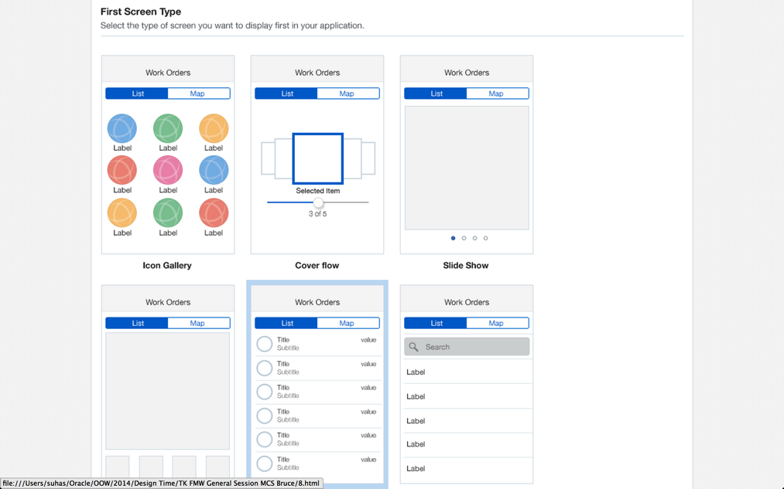
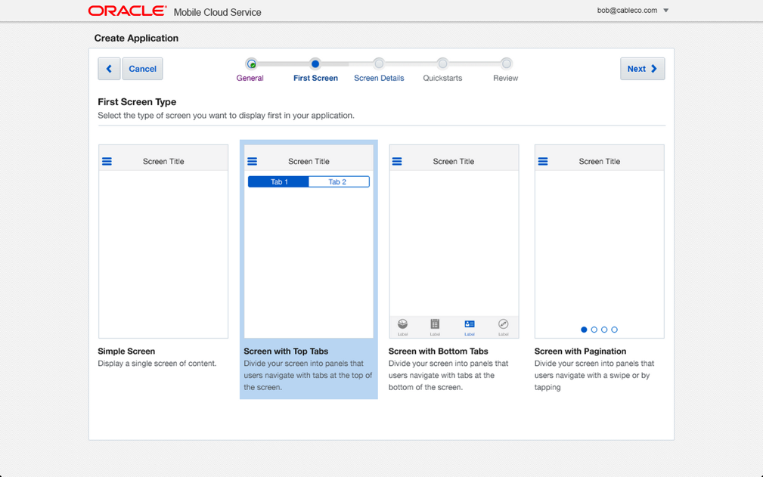

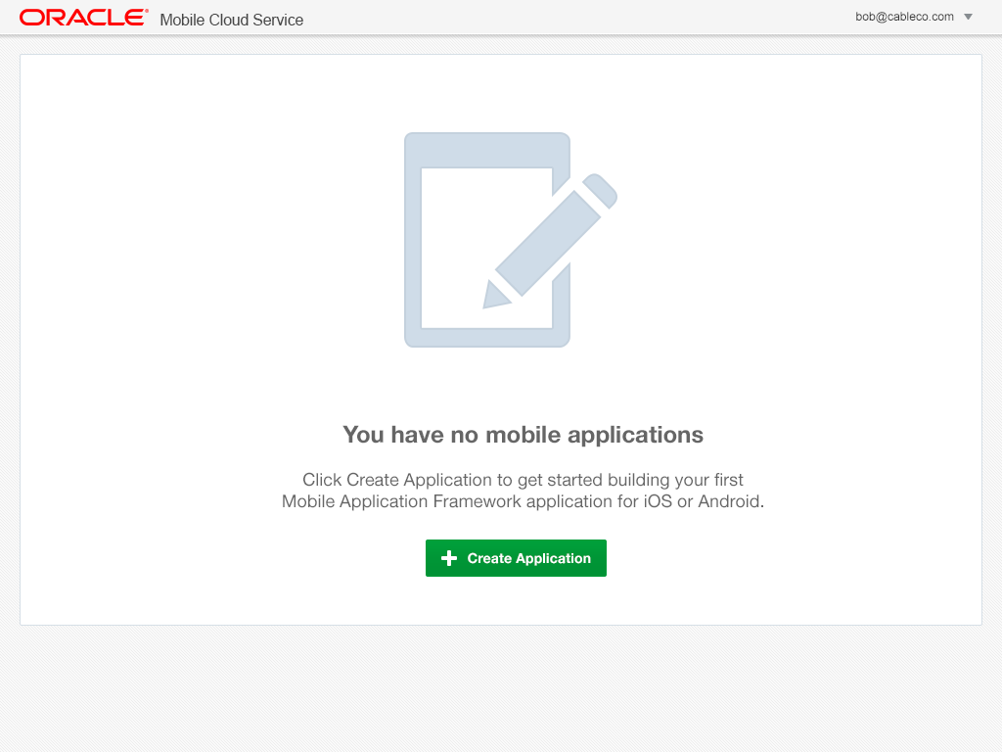
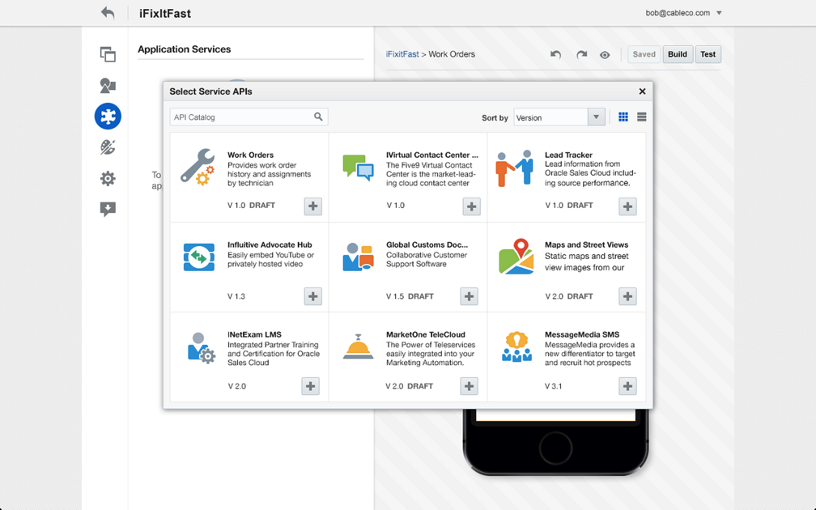
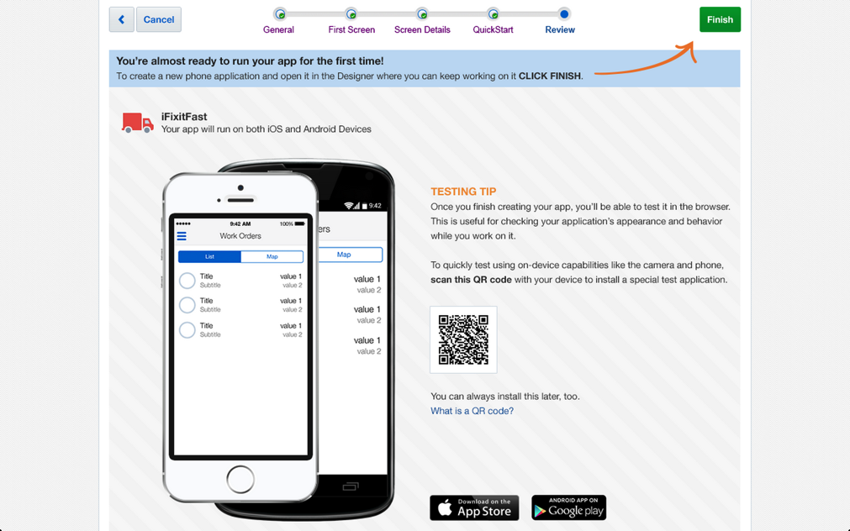
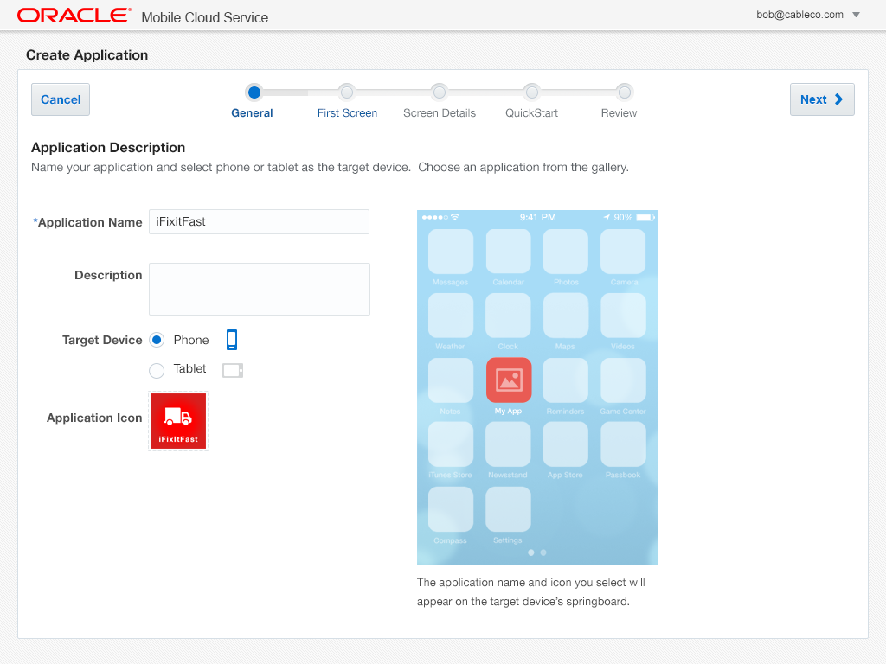
Mobile Application Accelerator (MAX)
Business User Friendly Mobile App Composition in the Cloud
Browser based development
No coding required
Easily map to business services
Preview app in line
Edit, test, and publish from browser
Notes:
Mobile Application Accelerator is a tool targeted at non developers to easily compose mobile applications without writing any line of code
MAX is a browser based tool to easily select screens from a pre set template and connect multiple screens together to create a business flow for a mobile application. This is done with no coding. MAX is integrated with MCS to consume the business services exposed in the MCS catalog. MAX enables the business user to preview the app in the browser without requiring emulators. The business users can perform all the functions of composing the app, editing it, testing and publishing from a browser. Once done they can download the app via a QR code.

Slide 27
Oracle Mobile Application Framework
@OracleMobile
Oracle Confidential – Highly Restricted
27

Slide 28
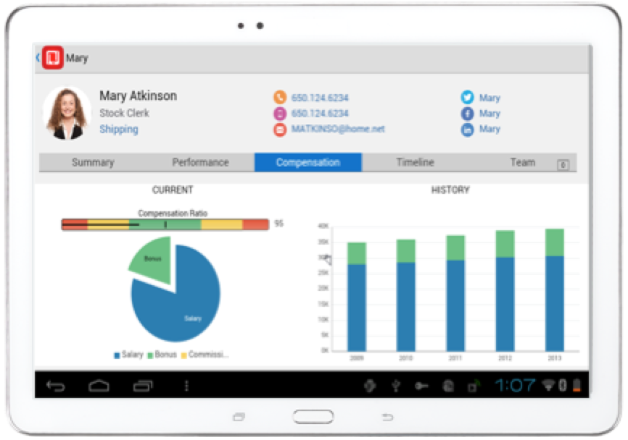


Develop: Oracle Mobile Application Framework
Productivity Boosting Framework
Build Once, Run on Multiple-Platform
Simpler Extensible UI development
Components, HTML5/JavaScript
Javascript / Java for business logic
Disconnected: SQLite with Encryption
Integrated Security
Full Access to Native Device Features
Modular, Reusable Application Components
In App configurability
Notes:
Main Point:
To develop mobile apps – Organizations can leverage the Mobile Application Framework, the only java framework designed to support cross platform development:
It enables developers to build a mobile app and being able to deploy it onto multiple devices, iOS, Android and on different form factors – oracle will be responsible for keep up with the changes in the mobile OS. Of course, we are also watching the other platform as the requirement for these increase we will support other operative systems.
The app is build with consistent business logic and data model, it can be native or HTML 5 with full access to native device feature. This allows you to leverage existing skill among your developers, any one with Java based skill set, can now build mobile apps.
It also leverage SQL-lite to support disconnected processes with built-in encryption.
Full Access to Native Device Features
The framework is designed to be modular with re-useable components that can be leveraged to simplify mobile app development.

Slide 29

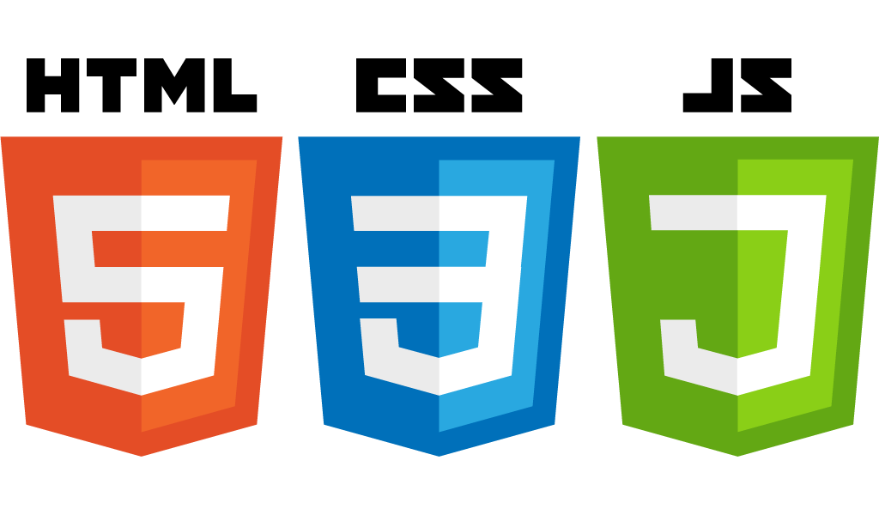



Mobile Application Framework Architecture
Configuration
MAF APPLICATION
App Config
WebView
Authorization, Credential Management & Access Control
Remote HTML
AMX controls
REST/SOAP
Services
Java 8 VM
Cordova
Encrypted
SQLite
Business Logic
Push
Notifications
MOBILE
DEVICE
Notes:
MAF has the following components as part of the architecture
A Device specific native container that executes the device resident mobile application
MAF is based on a model view controller paradigm that provides a clear separation of the UI, business logic and data
UI can be developed using the visual declarative drag and drop AMX feature that has over 80+ widgets
UI can also be developed in HTML5 / CSS using your favorite editor and run it locally in the native container
The app can also be remote app where the UI and the business logic is server side (connected mode) but the container provides the ability to integrate with local device features
Business logic can be written in Java or Javascript.
The container provides access to native device capabilities (camera, GPS etc) – write to one API run across all devices. We utilize the Cordova plug-ins for this
We have extended SLQ to encrypt data for any offline storage and processing
Prebuilt and integrated services to user access and governance (authentication and authorization)
Services to consume REST or SOAP data services and bind to the UI controls

Slide 30
Oracle Mobile Security Suite
@OracleMobile
Oracle Confidential – Highly Restricted
30

Slide 31
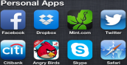



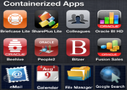


Oracle Mobile Security Suite:
Securely Separate And Manage Corporate Apps And Data On Devices
/
CONTROL
EXPERIENCE
CONTAINER
Isolate corporate data, support remote wipe, restrict data transfer
Secure applications & communication, corporate application store
Role based access, self service request, sign-on, fraud detection
Notes:
Main Point: From the BYOD perspective, Oracle is focused on three things:
Providing a secure container for IT owned apps and data, including the ability to add new applications to this container, that is separated from personal apps and data
Enabling secure connection and management of these mobile applications, including the ability to wipe apps and data without affecting personal data
Extending Identity services to these mobile applications so that users have the benefit of single sign-on and consistent entitlements across channels
Oracle Mobile Security Suite: Secures corporate applications and data on personal devices used for work purposes (BYOD) and delivers a consistent user experience across channels by extending identity services, such as fraud detection, user registration, access request, self-service password management and authorization management, to customer and employee digital interactions. Enables organizations to secure consumer facing mobile apps, distributed through popular app stores.

Slide 32

Customer Case Study: 7-11
OCS delivers “Digital Guest Experience” through FMW standardization and integration
Vision – transform their basic mobile app into a sophisticated marketing tool with targeted promotions, loyalty programs, personalization, etc
OCS delivered a standardized, secure, on-premise Mobile Backend-as-a-Service (MBaaS) platform – including integrations to non-Oracle SaaS Marketing platform and point-of-sale system
Services layer: Oracle SOA Suite, Oracle WebLogic Server, API Gateway, Oracle Services Bus, Oracle Traffic Director, and Exadata and Exalogic
7-Eleven’s new mobile app is live now live !

Slide 33





For More Information
Twitter
Facebook
Blogs
LinkedIn
YouTube
Visit: http://www.oracle.com/mobile
Notes:
With that please join us the rest of the day to learn more about Oracle’s Mobile Solution and our Mobile Platform.
Visit our website to learn more:
www.oracle.com/mobile
www.oracle.com/mobileplatform

Slide 35
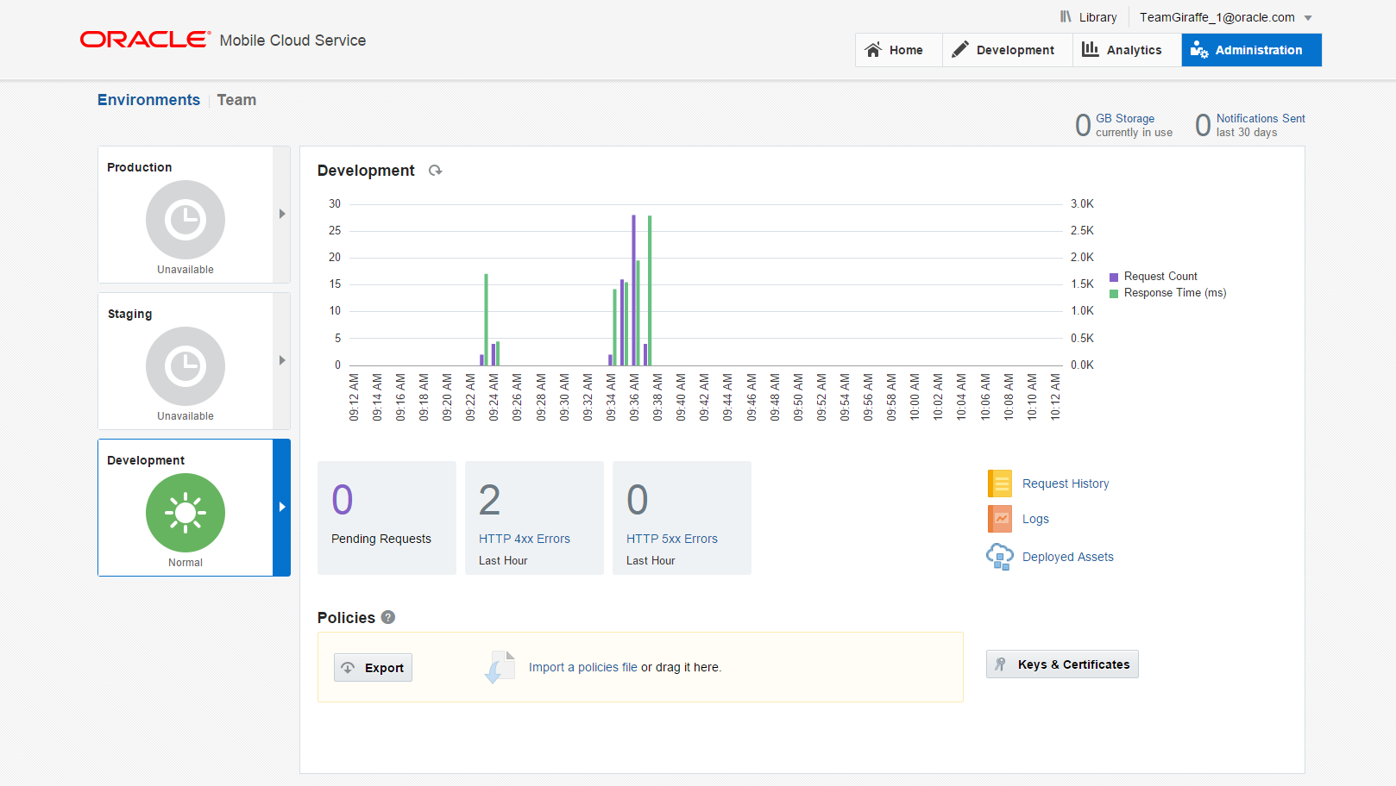
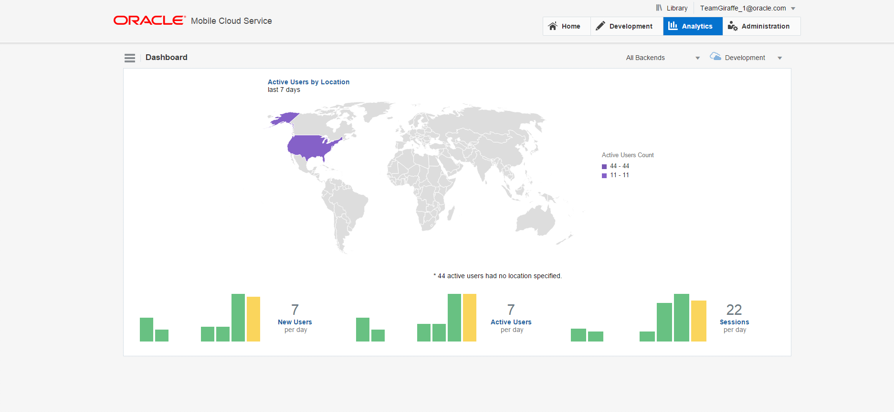
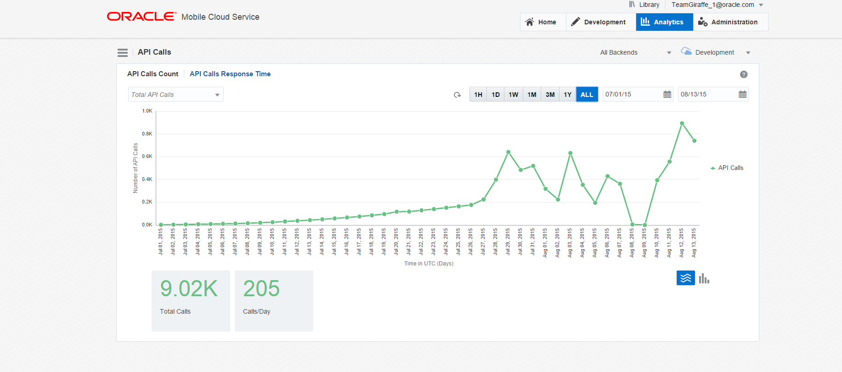
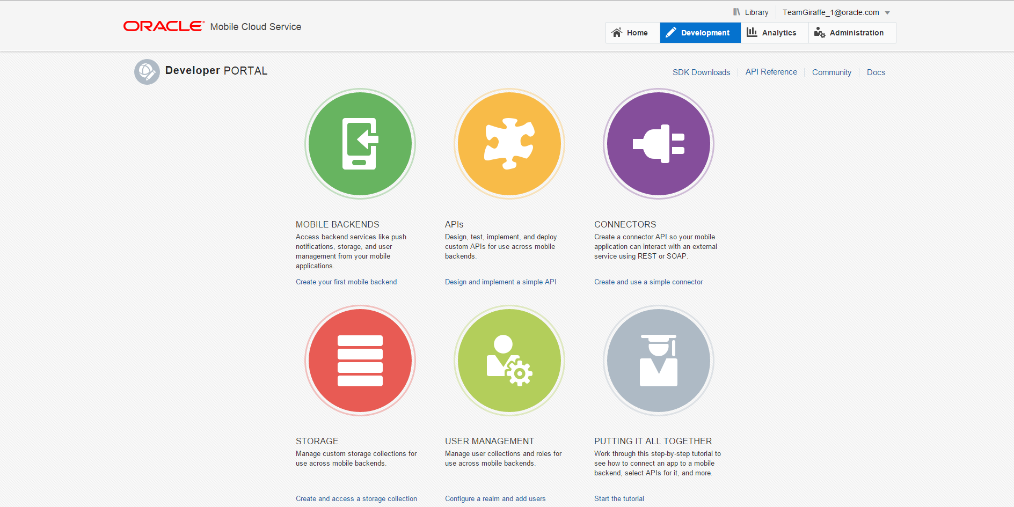
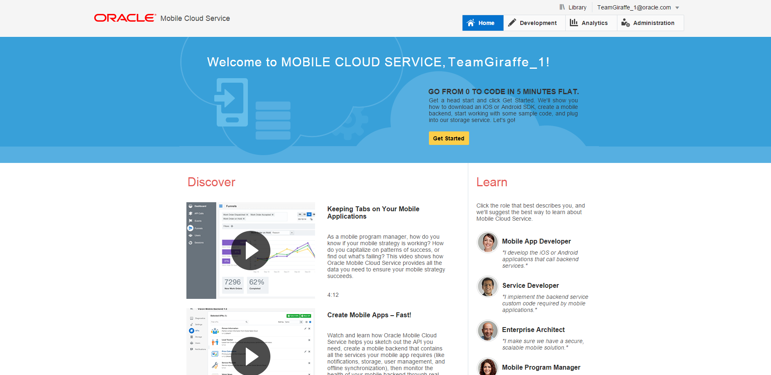
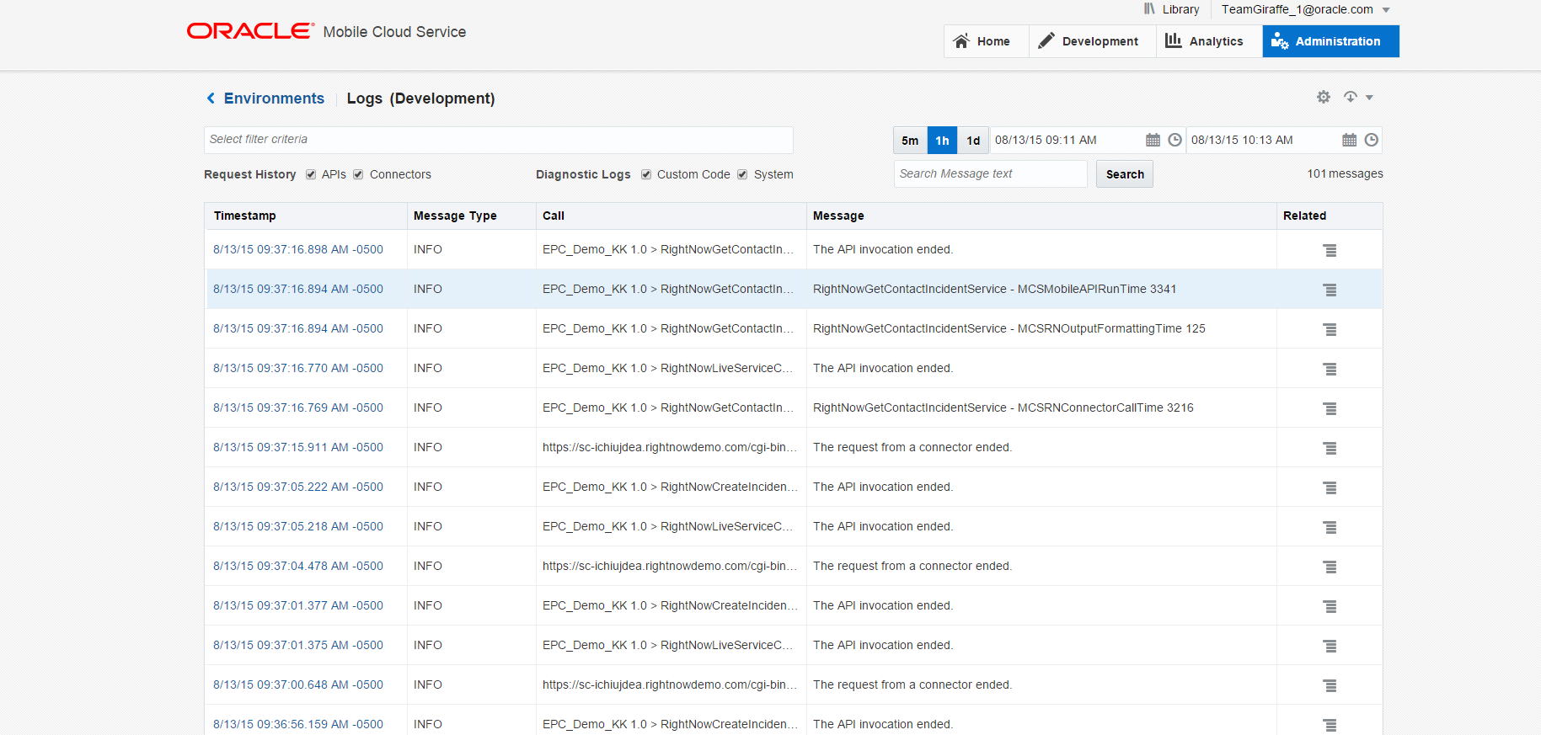
Developer Screenshots
No coding required
Business User Friendly Mobile App Composition in the Cloud
Notes:
Mobile Application Accelerator is a tool targeted at non developers to easily compose mobile applications without writing any line of code
MAX is a browser based tool to easily select screens from a pre set template and connect multiple screens together to create a business flow for a mobile application. This is done with no coding. MAX is integrated with MCS to consume the business services exposed in the MCS catalog. MAX enables the business user to preview the app in the browser without requiring emulators. The business users can perform all the functions of composing the app, editing it, testing and publishing from a browser. Once done they can download the app via a QR code.

